Slide 1
COMPUTER SYSTEM AND ORGANISATION (MODULE 5/6) BY Mrs. SUJATA PRADHAN PGT(SS),AECS,ANUPURAM

Slide 2
Boolean Algebra
Boolean Algebra is a system of mathematics based on logic that has its own set of rules or laws which are used to define and reduce Boolean expressions. It is used to analyze and simplify the digital (logic) circuits. The variables used in Boolean Algebra have only one of two possible values, a logic “0” and a logic “1”
Boolean algebra was invented by George Boole in 1854. He proposed that logical propositions(declarative statements) should be expressed as algebraic equations. As Boolean Algebra is based on only two binary numbers i.e. 0(False) and 1(True), It is also called as Binary Algebra or logical Algebra.
Boolean Algebra is made up of
1. Elements - variables or constants with value 1 or 0.
2. Operators - AND, OR and NOT etc.
3. Axioms and Theorems - self-evident universally accepted truth.
There are three ways to represent a Boolean Expression/Function.
1. Algebraic Equation
2. Truth Table
3. Circuit Diagram

Slide 3
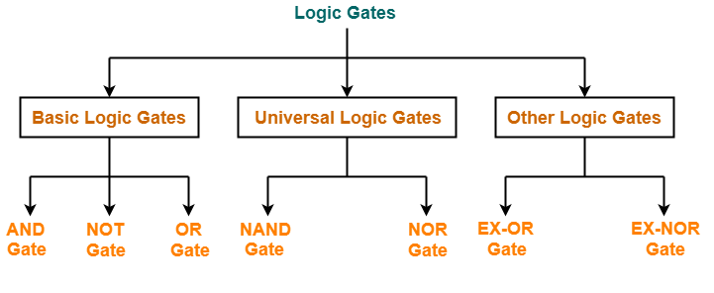
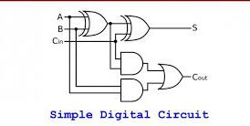
Logic gates
Digital systems are said to be constructed by using logic gates. Logic gates are the basic building blocks of any digital system. It is an electronic circuit having one or more than one input and only one output. There are several gates like AND, OR, NOT, NAND, NOR, EXOR and EXNOR used in designing electronic circuit. Using Laws of Boolean Algebra,We can reduce and simplify a complex Boolean expression in an attempt to reduce the number of logic gates required.

Slide 4
Fundamental gates
There are three fundamental Logic Gates.
AND gate: The AND gate is an electronic circuit that gives a high output (1) only if all its inputs are high. A dot (.) is used to show the AND operation i.e. A.B .This dot is sometimes omitted i.e. AB
OR gate: The OR gate is an electronic circuit that gives a high output (1) if one or more of its inputs are high. A plus (+) is used to show the OR operation. i.e. A + B
NOT gate: The NOT gate is an electronic circuit that produces an inverted version of the input at its output. It is also known as an inverter. If the input variable is A, the inverted output is known as NOT A. This is also shown as A', or A with a bar.

Slide 5
Truth Table of Fundamental Gates
The table used to represent the Boolean Expression of a logic gate function is commonly called a Truth Table. A logic gate truth table shows each possible input combination to the gate or circuit with the resultant output depending upon the combination of these input(s). consider a single 2-input logic circuit with input variables labelled as A and B. There are “four” possible input combinations or 2² of “OFF” and “ON” for the two inputs. “ON” or “OFF” represent a logic level “1” or a logic level “0” respectively.

Slide 6
Logical Operators (NOT)
The Logic NOT Function is a single input inverter that changes the input of a logic level “1” to an output of logic level “0” and vice versa. In Boolean algebra the inverting Logic NOT Function follows the Complementation Law producing inversion. As NOT gates perform the logic INVERT or COMPLEMENTATION function, they are more commonly known as Inverters because they invert the signal
Truth Table for NOT operator:
X | X’
0 | 1
1 | 0

Slide 7
Logical Operators (AND)
Logical AND operation is also known as Boolean AND operation. AND operator ( . ) is applied on two variables. Ex. X.Y
It shows a very important operation of Boolean Algebra which is known as logical multiplication.
X.Y is to be read as X AND Y
Rules of AND operation are-
0 . 0 = 0
0 . 1 = 0
1 . 0 = 0
1 . 1 = 1
Result will be 1 only when both the inputs will be 1 otherwise result will always be 0.
AND operator’s Truth Table
X | Y | X.Y
0 | 0 | 0
0 | 1 | 0
1 | 0 | 0
1 | 1 | 1

Slide 8
Logical Operators (OR)
OR operator ( + ) is also applied on two variables. Ex. X+Y
It shows a very important operation of Boolean Algebra known as logical addition.
X+Y is to be read as X OR Y.
Rules of OR operation are-
0 + 0 = 0
0 + 1 = 1
1 + 0 = 1
1 + 1 = 1
Result will be 1 when either of the input will 1 otherwise result will be 0.
AND operator’s Truth Table:
X | Y | X+Y
0 | 0 | 0
0 | 1 | 1
1 | 0 | 1
1 | 1 | 1

Slide 9
Universal Gates
In addition to AND, OR, and NOT ,fundamental gates, other logic gates like NAND and NOR are also used in the design of digital circuits. A universal gate is a gate which can implement any Boolean function without use of any other gate type. The NAND and NOR gates are universal gates. In practice, this is advantageous since NAND and NOR gates are economical and easier to fabricate all IC digital logic families.
NAND Gate: The NAND gate represents the complement of the AND operation. Its name is an abbreviation of NOT AND. The graphic symbol for the NAND gate consists of an AND symbol with a bubble on the output, denoting that a complement operation is performed.
NOR Gate: The NOR gate represents the complement of the OR operation. Its name is an abbreviation of NOT OR. The graphic symbol for the NOR gate consists of an OR symbol with a bubble on the output of the AND gate.

Slide 10
Other Logic Gates

Slide 11
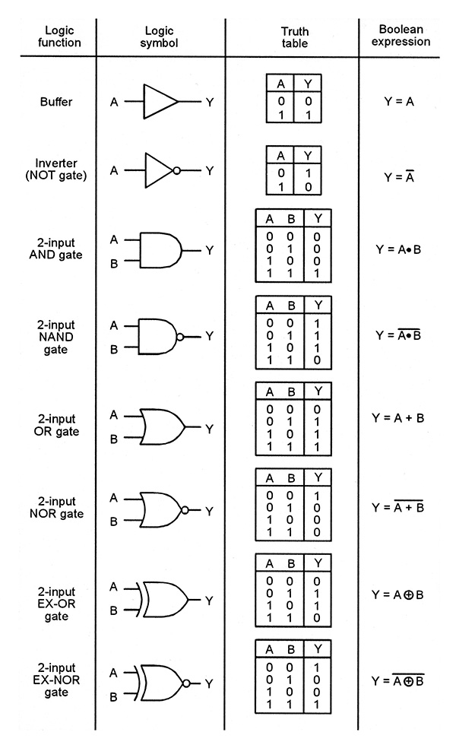
Logic Gates & Truth Tables
The table used to represent the Boolean Expression of a logic gate function is commonly called a Truth Table. A logic gate truth table shows each possible input combination to the gate or circuit with the resultant output depending upon the combination of these input(s).

Slide 12
Laws of Boolean Algebra
Each postulate and theorem of boolean algebra has two parts and one is dual of another.
Annulment Law – A term AND´ed with a “0” equals 0 or OR´ed with a “1” will equal 1
A . 0 = 0 A variable AND’ed with 0 is always equal to 0
A + 1 = 1 A variable OR’ed with 1 is always equal to 1
Identity Law – A term OR´ed with a “0” or AND´ed with a “1” will always equal that term
A + 0 = A A variable OR’ed with 0 is always equal to the variable
A . 1 = A A variable AND’ed with 1 is always equal to the variable
Idempotent Law – An input that is AND´ed or OR´ed with itself is equal to that input
A + A = A A variable OR’ed with itself is always equal to the variable
A . A = A A variable AND’ed with itself is always equal to the variable
Complement Law – A term AND´ed with its complement equals “0” and a term OR´ed with its complement equals “1”
A . A’ = 0 A variable AND’ed with its complement is always equal to 0
A + A’ = 1 A variable OR’ed with its complement is always equal to 1

Slide 13
Laws of Boolean Algebra
Commutative Law – The order of application of two separate terms is not important
A . B = B . A The order in which two variables are AND’ed makes no difference
A + B = B + A The order in which two variables are OR’ed makes no difference
Double Negation Law – A term that is inverted twice is equal to the original term
(A’)’ = A A double complement of a variable is always equal to the variable
Distributive Law – This law permits the multiplying or factoring out of an expression.
A.(B + C) = A.B + A.C (OR Distributive Law)
A + (B.C) = (A + B).(A + C) (AND Distributive Law)
Absorptive Law – This law enables a reduction in a complicated expression to a simpler one by absorbing like terms.
A + (A.B) = A (OR Absorption Law)
A.(A + B) = A (AND Absorption Law)
Associative Law – This law allows the removal of brackets from an expression and regrouping of the variables.
A + (B + C) = (A + B) + C = A + B + C (OR Associate Law)
A(B.C) = (A.B)C = A . B . C (AND Associate Law)

Slide 14
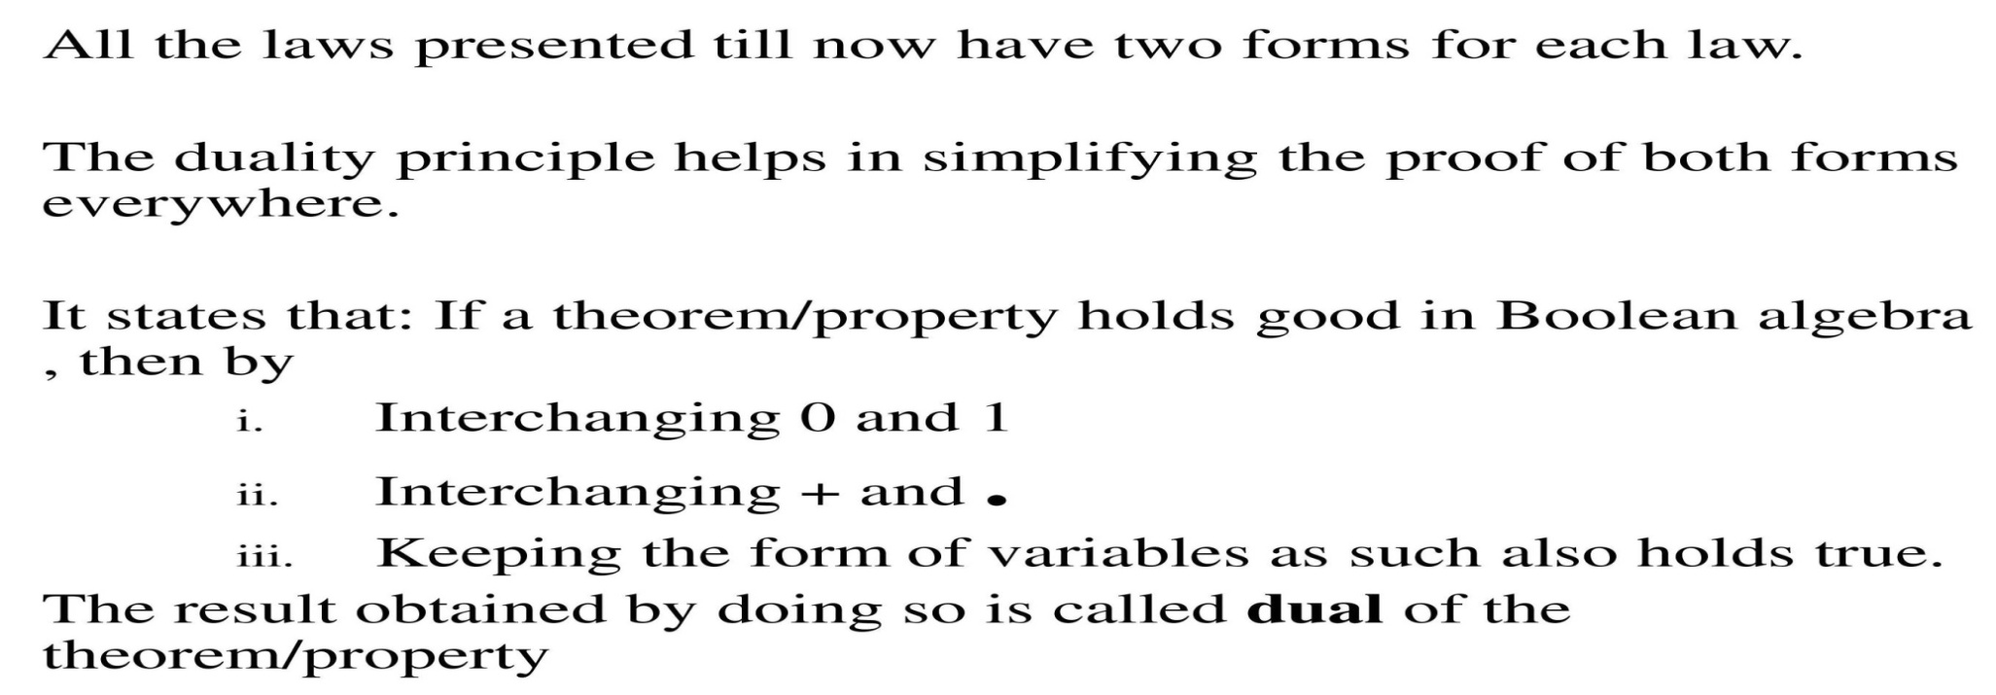
Principle of Duality
It is a very important concept of boolean logic. A new boolean relation can be derived from another boolean relation if we follow following rules:
Dual of 0 + 0 = 0 is 1 . 1 = 1
Dual of 0 + 1 = 1 is 1 . 0 = 0
Dual of 1 + 0 = 1 is 0 . 1 = 0
Dual of 1 + 1 = 1 is 1 . 1 = 1

Slide 15
Properties of Boolean Algebra
I. Properties of 0 and 1 0 + X = X 1 + X = 1
0 + X = X
1 + X = 1
0 . X = 0
1 . X = X
0 | X | R
0 | 0 | 0
0 | 1 | 1
1 | X | R
1 | 0 | 1
1 | 1 | 1
0 . X = 0
1 . X = X
0 | X | R
0 | 0 | 0
0 | 1 | 0
1 | X | R
1 | 0 | 0
1 | 1 | 1
II. Idempotence Law -
(a) X + X = X
(b) X . X = X
X | X | R
0 | 0 | 0
1 | 1 | 1
X | X | R
0 | 0 | 0
1 | 1 | 1

Slide 16
Laws of Boolean Algebra
III.
Involution – (X’)’ = X
X | X’ | (X’)’
0 | 1 | 0
1 | 0 | 1
IV. Complementarity Law –
(a) X + X’ = 1
(b) X . X’ = 0
X | X’ | R
0 | 1 | 1
1 | 0 | 1
X | X’ | R
0 | 1 | 0
1 | 0 | 0
V. Commutative Law –
(a) X + Y = Y + X
(b) X . Y = Y . X
X | Y | X + Y | Y + X
0 | 0 | 0 | 0
0 | 1 | 1 | 1
1 | 0 | 1 | 1
1 | 1 | 1 | 1
X | Y | X . Y | Y . X
0 | 0 | 0 | 0
0 | 1 | 0 | 0
1 | 0 | 0 | 0
1 | 1 | 1 | 1

Slide 17
Associative Law
X+(Y+Z) = (X+Y)+Z
X | Y | Z | Y + Z | X + Y | X+ (Y + Z) | (X + Y) + Z
0 | 0 | 0 | 0 | 0 | 0 | 0
0 | 0 | 1 | 1 | 0 | 1 | 1
0 | 1 | 0 | 1 | 1 | 1 | 1
0 | 1 | 1 | 1 | 1 | 1 | 1
1 | 0 | 0 | 0 | 1 | 1 | 1
1 | 0 | 1 | 1 | 1 | 1 | 1
1 | 1 | 0 | 1 | 1 | 1 | 1
1 | 1 | 1 | 1 | 1 | 1 | 1

Slide 18
Associative Law
X . (Y . Z) = (X . Y). Z
X | Y | Z | Y . Z | X . Y | X . (Y . Z) | (X . Y) . Z
0 | 0 | 0 | 0 | 0 | 0 | 0
0 | 0 | 1 | 0 | 0 | 0 | 0
0 | 1 | 0 | 0 | 0 | 0 | 0
0 | 1 | 1 | 1 | 0 | 0 | 0
1 | 0 | 0 | 0 | 0 | 0 | 0
1 | 0 | 1 | 0 | 0 | 0 | 0
1 | 1 | 0 | 0 | 1 | 0 | 0
1 | 1 | 1 | 1 | 1 | 1 | 1

Slide 19
Distributive Law
X . (Y + Z) = X.Y + X.Z
X | Y | Z | Y+Z | X.Y | X.Z | X.(Y+Z) | X.Y+X.Z
0 | 0 | 0 | 0 | 0 | 0 | 0 | 0
0 | 0 | 1 | 1 | 0 | 0 | 0 | 0
0 | 1 | 0 | 1 | 0 | 0 | 0 | 0
0 | 1 | 1 | 1 | 0 | 0 | 0 | 0
1 | 0 | 0 | 0 | 0 | 0 | 0 | 0
1 | 0 | 1 | 1 | 0 | 1 | 1 | 1
1 | 1 | 0 | 1 | 1 | 0 | 1 | 1
1 | 1 | 1 | 1 | 1 | 1 | 1 | 1

Slide 20
Distributive Law
X + Y.Z = (X + Y) . (X + Z)
X | Y | Z | Y . Z | X + Y | X + Z | X + Y . Z | (X+Y) . (X+Z)
0 | 0 | 0 | 0 | 0 | 0 | 0 | 0
0 | 0 | 1 | 0 | 0 | 1 | 0 | 0
0 | 1 | 0 | 0 | 1 | 0 | 0 | 0
0 | 1 | 1 | 1 | 1 | 1 | 1 | 1
1 | 0 | 0 | 0 | 1 | 1 | 1 | 1
1 | 0 | 1 | 0 | 1 | 1 | 1 | 1
1 | 1 | 0 | 0 | 1 | 1 | 1 | 1
1 | 1 | 1 | 1 | 1 | 1 | 1 | 1

Slide 21
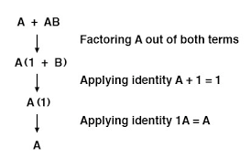
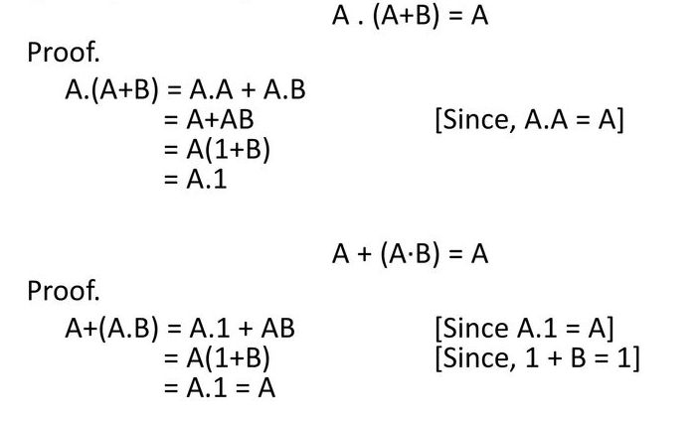
Absorption Law
X + X . Y = X (b) X . (X + Y) = X
X | Y | X.Y | X+X.Y
0 | 0 | 0 | 0
0 | 1 | 0 | 0
1 | 0 | 0 | 1
1 | 1 | 1 | 1
X | Y | X + Y | X.(X+Y)
0 | 0 | 0 | 0
0 | 1 | 1 | 0
1 | 0 | 1 | 1
1 | 1 | 1 | 1

Slide 22
SUMMARY
Basic elements of Boolean Algebra
Different representations of Boolean Expression
Different types of Logic Gates and Truth Tables
Laws Of Boolean Algebra
Principle of Duality

Slide 23
THANK YOU

